Slide 1

An understanding of environmental issues: Climate change; Global warming
Information Security Fundamentals | Climate Change (Impacts, Adaptation and Mitigation)
Course: Information Security Fundamentals | Chapter: Climate Change (Impacts, Adaptation and Mitigation) | Program: Bachelor of Engineering
DISCOVER · LEARN · EMPOWER
Notes:
Welcome everyone to this lecture on environmental issues. We are focusing specifically on the critical topics of climate change and global warming. As future engineers, understanding these dynamics is essential for your professional responsibility. Let us begin by defining the core concepts that drive our current environmental crisis.

Slide 2
Course Outcomes
SLIDE 2 / 14
Course Outcome
CO | BT LEVEL | DESCRIPTION
CO1 | BT4 | Recall, analyze and respond on fundamental environmental principles, such as ecological relationships and conservation strategies
CO2 | BT4 | Understand and analyze the interconnections between human activities and environmental impacts across different ecosystems
CO3 | BT4 | Understand and analyze and apply environmental laws and policies to analyse and propose solutions for real-world environmental challenges.
CO4 | BT2 | Students will analyse data from environmental monitoring programs to assess trends and predict future impacts on ecosystems.
CO5 | BT6 | Interpret, elaborate and propose various tools, design and innovative strategies for sustainable development and environmental conservation initiatives in securing the planet.
Chandigarh University
2 / 14
Notes:
This lecture directly addresses Course Outcome 3, which requires you to analyze and apply environmental laws. We will not just discuss theories but look at how policies address the root causes of climate change. By the end, you should be able to propose solutions based on these legal frameworks. This outcome ensures you can tackle real-world environmental challenges effectively.

Slide 3
Learning Objectives
SLIDE 3 / 14
Learning Outcomes
1
Analyze the fundamental distinction between global warming and climate change phenomena.
2
Evaluate the primary anthropogenic drivers contributing to the enhanced greenhouse effect.
3
Calculate the radiative forcing impact of specific greenhouse gas concentration increases.
4
Assess the immediate and long-term environmental impacts of rising global temperatures.
5
Propose mitigation strategies based on current scientific understanding of carbon cycles.
Chandigarh University
3 / 14
Notes:
By the end of this session, you will be able to distinguish clearly between global warming and climate change. You will learn to evaluate the human drivers behind these shifts and calculate their radiative forcing. We will also assess the tangible impacts on our environment and propose viable mitigation strategies. These skills are crucial for your engineering analysis of environmental challenges.

Slide 4
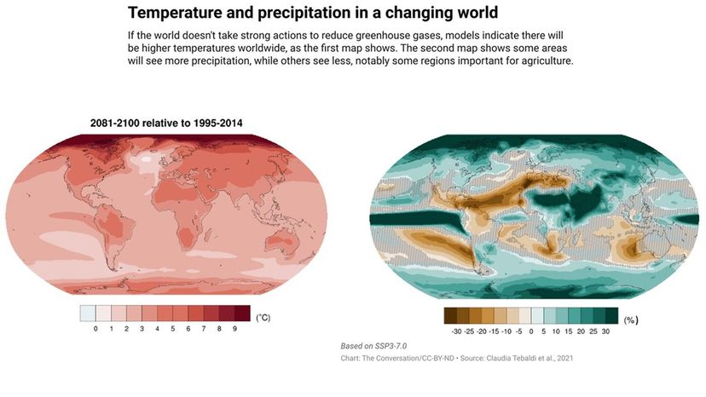
Lecture
SLIDE 4 / 14
Defining Global Warming and Climate Change
1
Global warming refers specifically to the long-term rise in Earth's average surface temperature.
2
Climate change encompasses global warming plus shifts in weather patterns and sea levels.
3
Global warming is a subset of the broader phenomenon known as climate change.
4
The term climate change includes regional variations like droughts and extreme storms.
5
Scientific consensus confirms human activity is the dominant cause of recent warming trends.
6
Distinguishing these terms is vital for accurate policy formulation and engineering solutions.
7
Global warming is the temperature metric, while climate change is the systemic impact.
6 Charts to Help Explain Climate Change | HowStuffWorks
Chandigarh University
4 / 14
Notes:
It is crucial to distinguish between these two terms as they are often used interchangeably but mean different things. Global warming is the specific metric of rising temperatures, whereas climate change includes the broader systemic impacts like extreme weather. Think of global warming as the fever and climate change as the entire illness affecting the body. Understanding this distinction helps in formulating precise engineering and policy responses.

Slide 5
Lecture
SLIDE 5 / 14
The Greenhouse Effect Mechanism
1
The greenhouse effect traps infrared radiation in the atmosphere to maintain habitable temperatures.
2
Natural greenhouse gases include water vapor, carbon dioxide, and methane in the air.
3
Anthropogenic activities have increased the concentration of these gases beyond natural levels.
4
Increased gas concentration thickens the atmospheric blanket, trapping more heat energy.
5
Without this effect, Earth's average temperature would be approximately -18°C instead of 15°C.
6
The enhanced greenhouse effect is the primary driver of current global warming trends.
7
Radiative forcing measures the imbalance between incoming solar energy and outgoing heat.
Chandigarh University
5 / 14
Notes:
The greenhouse effect is a natural process that keeps our planet warm enough for life. However, human activities have thickened this atmospheric blanket, trapping excess heat and causing the enhanced greenhouse effect. Imagine the atmosphere as a blanket; adding more layers makes it harder for heat to escape. This imbalance is the fundamental mechanism driving the climate crisis we face today.

Slide 6
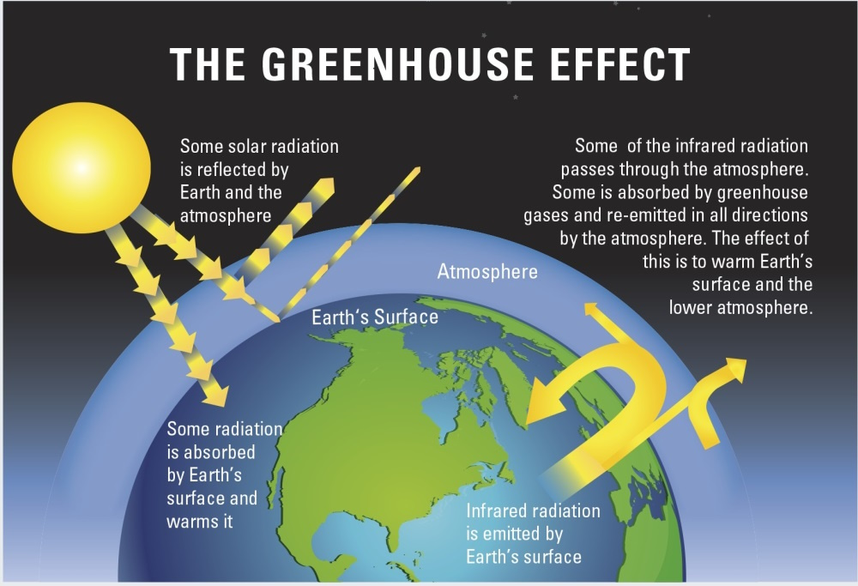
Lecture
SLIDE 6 / 14
Primary Anthropogenic Drivers of Warming
1
Burning fossil fuels for energy releases massive amounts of carbon dioxide into the atmosphere.
2
Deforestation reduces the planet's capacity to absorb carbon dioxide through photosynthesis.
3
Industrial agriculture and livestock farming are major sources of methane and nitrous oxide.
4
Cement production and chemical manufacturing release significant quantities of process-related greenhouse gases.
5
Waste decomposition in landfills generates methane, a potent greenhouse gas with high impact.
6
Transportation sectors contribute heavily through the combustion of gasoline and diesel fuels.
7
These activities collectively alter the atmospheric composition and drive global temperature rise.
Climate change: evidence and causes | Royal Society (source: royalsociety.org)
Chandigarh University
6 / 14
Notes:
The primary drivers of this warming are human activities that release greenhouse gases. Burning fossil fuels is the largest contributor, releasing carbon dioxide that has been stored underground for millions of years. Deforestation and agriculture also play critical roles by reducing carbon sinks and releasing methane. These activities collectively alter the atmospheric composition, creating a feedback loop that accelerates warming.

Slide 7
Worked Example
SLIDE 7 / 14
Radiative Forcing Calculation
GOVERNING EQUATION
Formula: RF = α × ln(C / C₀)
C is current concentration and C₀ is baseline.
1
Radiative forcing (RF) estimates the change in energy balance due to gas increases.
2
For CO₂, α is approximately 5.35 W/m², and C₀ is 280 ppm pre-industrial.
3
If current CO₂ is 420 ppm, RF = 5.35 × ln(420 / 280) ≈ 2.2 W/m².
4
A positive RF indicates more energy entering than leaving, causing warming.
5
This calculation quantifies the immediate thermal impact of specific emission scenarios.
6
Engineers use this metric to evaluate the effectiveness of mitigation technologies.
Chandigarh University
7 / 14
Notes:
Let's look at a worked example to quantify this impact. Using the formula RF = α × ln(C / C₀), we can calculate the forcing. If current CO₂ is 420 ppm compared to a baseline of 280 ppm, the forcing is approximately 2.2 W/m². This positive value means the Earth is absorbing more energy than it releases, directly causing the temperature rise. This calculation is essential for engineers to assess mitigation strategies.

Slide 8
Lecture
SLIDE 8 / 14
Common Pitfalls in Climate Analysis
1
Confusing weather variability with long-term climate trends leads to incorrect conclusions.
2
Ignoring the lag time between emissions and peak temperature effects in models.
3
Overlooking regional differences where some areas may experience cooling temporarily.
4
Attributing all extreme weather events directly to climate change without statistical proof.
5
Focusing only on CO₂ while neglecting the higher potency of methane and N₂O.
6
Assuming linear relationships between emissions and temperature when feedback loops exist.
7
Neglecting the role of aerosols which can have a temporary cooling masking effect.
Climate change: evidence and causes | Royal Society (source: royalsociety.org)
Chandigarh University
8 / 14
Notes:
There are several common pitfalls students and analysts often fall into during climate analysis. One major error is confusing short-term weather variability with long-term climate trends. Another is ignoring the lag time between emissions and the full temperature response. It is also crucial not to overlook regional differences or the masking effects of aerosols. Avoiding these errors ensures your engineering solutions are based on robust scientific evidence.

Slide 9
Environmental Impacts
SLIDE 9 / 14
Temperature and Ice
1
Rising temperatures cause thermal expansion of oceans, contributing significantly to sea-level rise.
2
Melting polar ice caps and glaciers add substantial volumes of water to the oceans.
3
Glacial retreat threatens freshwater supplies for billions of people in mountainous regions.
4
Permafrost thawing releases stored methane, creating a dangerous positive feedback loop.
5
Ocean acidification occurs as seawater absorbs excess CO₂, harming marine ecosystems.
6
Heatwaves are becoming more frequent, intense, and longer-lasting across the globe.
7
These physical changes directly threaten coastal infrastructure and agricultural productivity.
Chandigarh University
9 / 14
Notes:
The physical impacts of climate change are already visible and accelerating. Rising temperatures cause thermal expansion and melting ice, leading to sea-level rise that threatens coastal cities. Permafrost thawing releases stored methane, creating a dangerous feedback loop that accelerates warming further. These changes directly threaten freshwater supplies and marine ecosystems, requiring urgent engineering interventions.

Slide 10
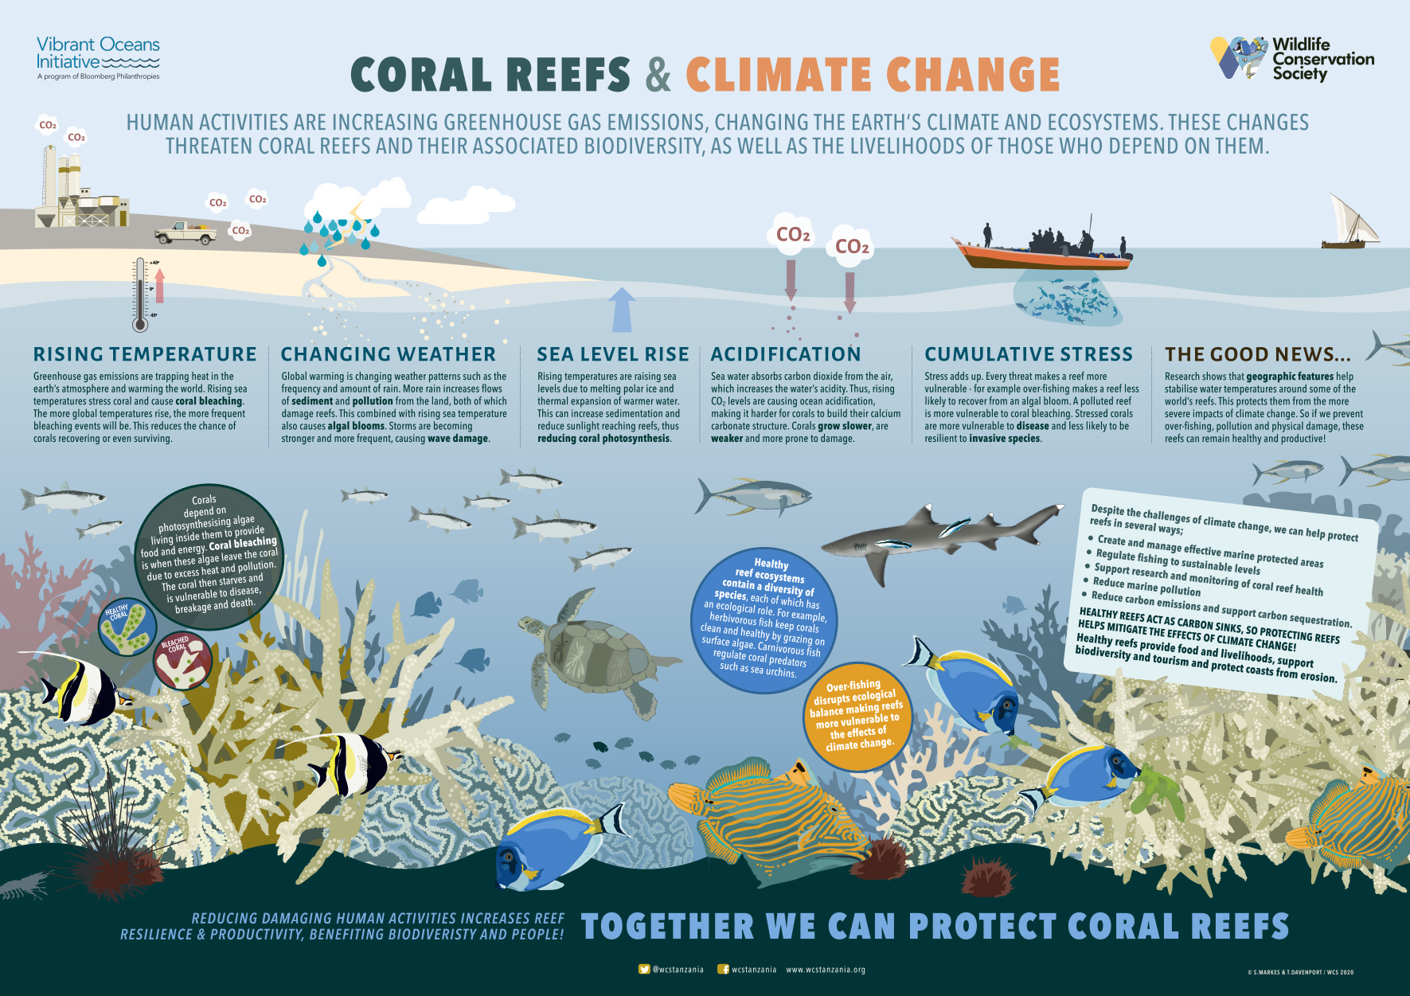
Environmental Impacts
SLIDE 10 / 14
Biodiversity and Weather
1
Shifting climate zones force species to migrate, often leading to habitat loss and extinction.
2
Coral reefs are bleaching rapidly due to rising ocean temperatures and acidification.
3
Extreme weather events like hurricanes and floods are increasing in frequency and intensity.
4
Agricultural productivity is declining in many regions due to unpredictable rainfall patterns.
5
Droughts are becoming more severe, impacting water security and food production systems.
6
Ecosystem services such as pollination and water purification are being disrupted globally.
7
Biodiversity loss reduces the resilience of natural systems to environmental shocks.
Source: blog.wcs.org
Chandigarh University
10 / 14
Notes:
The impacts extend beyond temperature to biodiversity and weather patterns. Shifting climate zones force species to migrate, often leading to habitat loss and extinction. Coral reefs are bleaching rapidly, and extreme weather events are becoming more frequent and intense. These disruptions threaten agricultural productivity and water security, highlighting the interconnectedness of our environmental systems.

Slide 11
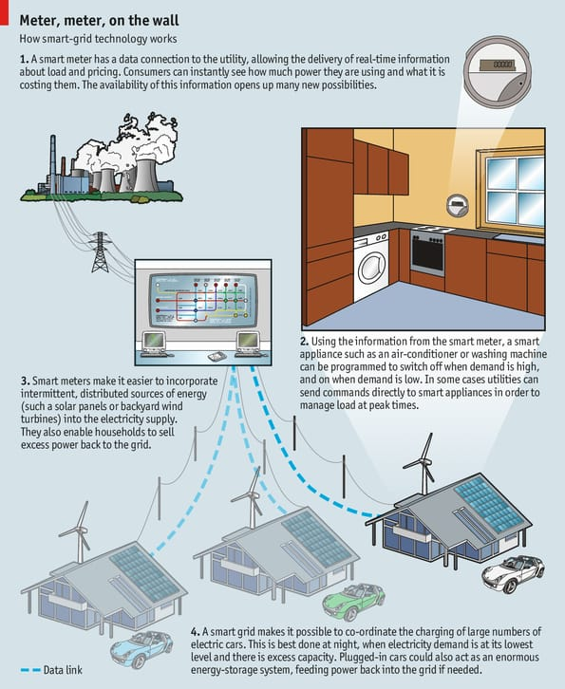
Mitigation Strategies
SLIDE 11 / 14
Energy Transition
1
Transitioning to renewable energy sources like solar and wind reduces carbon emissions.
2
Improving energy efficiency in buildings and industries lowers overall energy demand.
3
Electrifying transportation systems reduces reliance on fossil fuel-based internal combustion engines.
4
Carbon capture and storage technologies can remove CO₂ from industrial emission streams.
5
Smart grids optimize energy distribution to integrate variable renewable energy sources effectively.
6
Policy incentives and carbon pricing mechanisms drive market adoption of clean technologies.
7
Engineering innovation is central to scaling these mitigation solutions globally.
Source: www.economist.com
Chandigarh University
11 / 14
Notes:
Mitigation strategies focus on reducing the root causes of climate change. Transitioning to renewable energy sources like solar and wind is the most critical step. Improving energy efficiency and electrifying transportation further reduce our carbon footprint. Engineering innovation is central to scaling these solutions, supported by policy incentives and carbon pricing mechanisms.

Slide 12
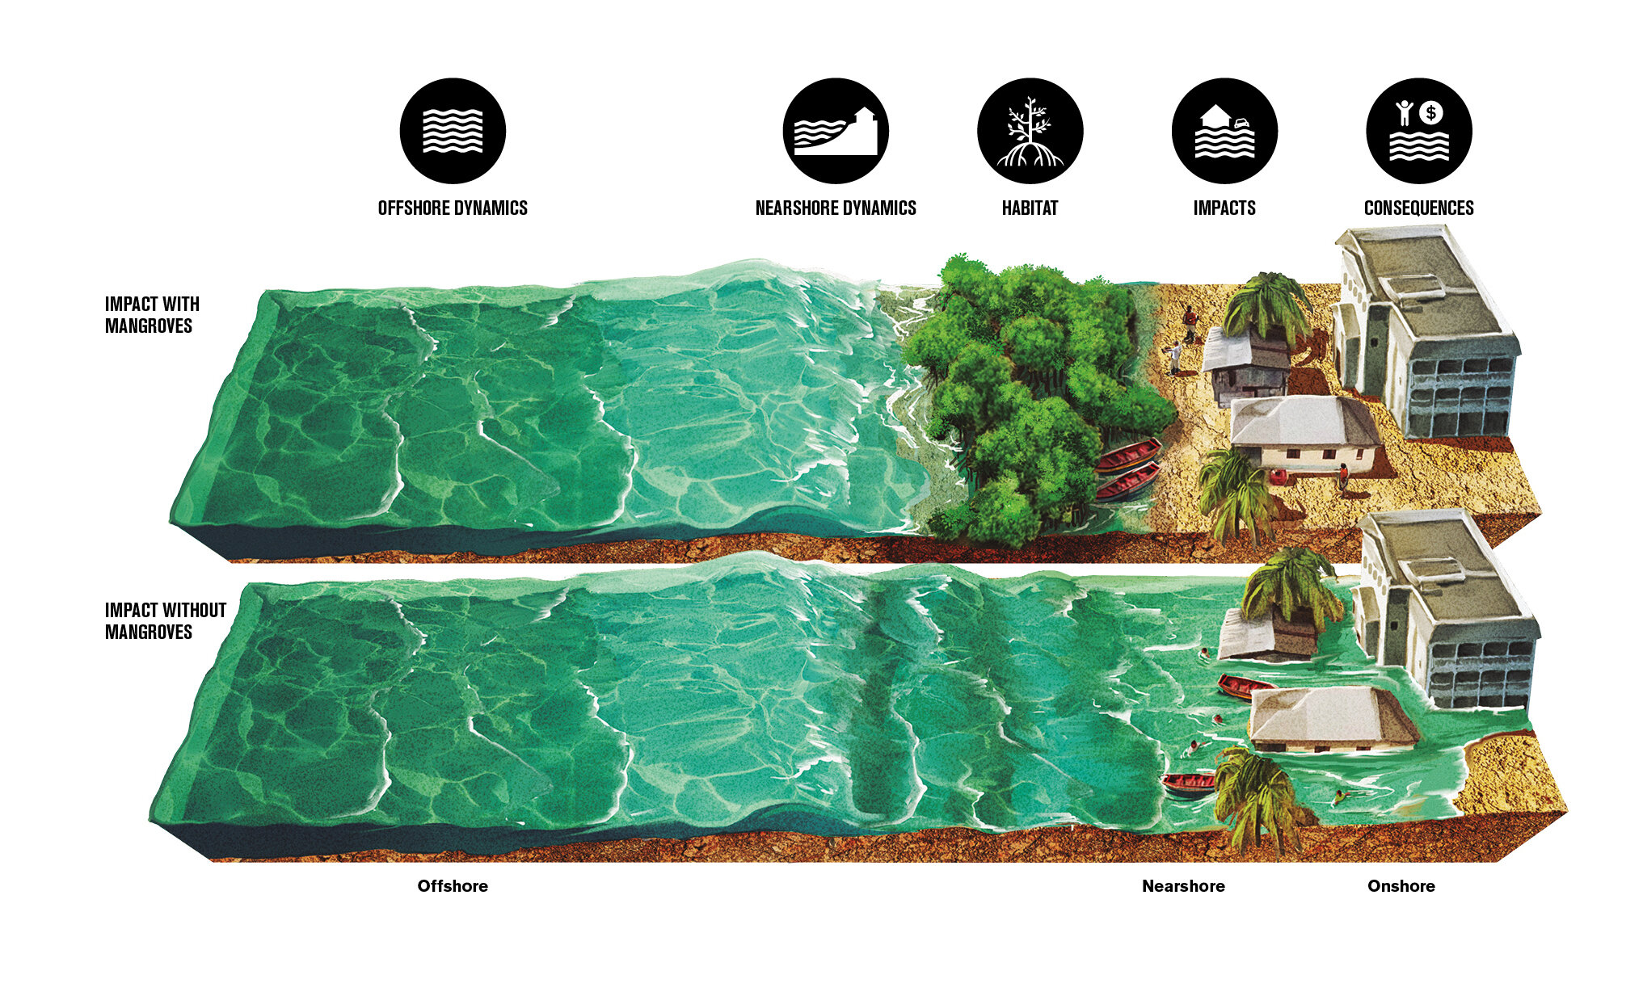
Adaptation Strategies
SLIDE 12 / 14
Resilience Building
1
Building sea walls and flood defenses protects coastal communities from rising sea levels.
2
Developing drought-resistant crop varieties ensures food security in changing climates.
3
Urban planning must incorporate green spaces to mitigate urban heat island effects.
4
Water management systems need upgrades to handle increased variability in rainfall.
5
Early warning systems for extreme weather events save lives and reduce economic loss.
6
Restoring wetlands and mangroves provides natural buffers against storm surges.
7
Adaptation complements mitigation by managing unavoidable impacts of current climate changes.
Source: scx2.b-cdn.net
Chandigarh University
12 / 14
Notes:
While mitigation addresses the cause, adaptation strategies manage the unavoidable impacts. Building sea walls and flood defenses protects coastal communities from rising sea levels. Developing drought-resistant crops and upgrading water management systems ensures resilience. These strategies are essential for protecting lives and infrastructure in a changing climate.

Slide 13

Lecture
SLIDE 13 / 14
Key Takeaways
1
Global warming is the temperature rise, while climate change includes broader systemic impacts.
2
Human activities, especially fossil fuel combustion, are the primary drivers of warming.
3
Radiative forcing quantifies the energy imbalance causing the enhanced greenhouse effect.
4
Impacts include sea-level rise, biodiversity loss, and increased extreme weather events.
5
Mitigation reduces emissions, while adaptation builds resilience against unavoidable changes.
6
Engineering solutions are critical for implementing both mitigation and adaptation strategies.
Source: slidemodel.com
Chandigarh University
13 / 14
Notes:
To summarize, global warming is the temperature rise, while climate change includes broader systemic impacts. Human activities are the primary drivers, and radiative forcing quantifies the energy imbalance. The impacts are severe, including sea-level rise and biodiversity loss. Engineering solutions are critical for implementing both mitigation and adaptation strategies to secure our future.

Slide 14
Lecture
SLIDE 14 / 14
References
ENVIRONMENTAL STUDIES
From Crisis to Cure — R. Rajagopalan
• Environmental Science and Engineering — Benny Joseph
• Environmental Studies — R.C. Sharma and D. Gurbir Sangha
• Introduction to Environmental Science — Anjaneyulu, Y.
• Environmental Pollution Control Engineering — C.S. Rao
• Textbook of Environmental Studies for undergraduate courses — E. Bharucha
• Environmental Science — S.C. Santra
Chandigarh University
14 / 14
Notes:
These references provide the foundational knowledge for understanding environmental issues and climate change. They cover the scientific principles, policy frameworks, and engineering solutions discussed in this lecture. I encourage you to consult these texts for deeper insights into specific case studies and technical details. Thank you for your attention, and I look forward to your questions.

